Slide 1
HL ONLY!
TOPIC A3:
DATABASES
LESSON A3-6
DATABASE TYPES & DATA WAREHOUSES

Slide 2
AGENDA
NoSQL Databases
Document Databases
Key-Value Databases
Wide-column Store Databases
Graph Databases
Cloud Databases
Spatial Databases
In-memory Databases
Data Warehouses
NOTE!
Have a way to take notes and a way to write code available for this lesson

Slide 3

THE WARM UP QUESTION
Suppose that you’re designing a database for a library
You need to store information about Books, Authors, and Borrowers
What tables would you create
What attributes would they have, and what would their primary keys be?
What foreign keys would connect the tables?

Slide 4
THE WARM UP ANSWER
Books(ISBN, AuthorID, BookName)
Author(AuthorID, FirstName, LastName)
Borrowers(BorrowerID, FirstName, LastName)
Borrows(BorrowerID, ISBN, Date)

Slide 5
DATABASE MODELS
Database models are different frameworks that determine the logical structure of a database
This can change how data is stored, organized, or manipulated
The different models cater to different types of applications and requirements
For the most part, in this class we discuss relational databases
We’ll be dipping our toes into some alternate database schemes

Slide 6
DATABASE MODELS
NoSQL Databases
Document Databases
Key-value Databases
Wide-column Store Databases
Graph Databases
Cloud Databases
Spatial Databases
In-memory Databases
Data Warehouses

Slide 7
NOSQL DATABASES
NoSQL databases are designed to handle large volumes of data with diverse data types
Flexible and scalable, often used for modern web applications
E-commerce platforms
Big Data (Route calculations for Google Maps)
Real-time Analytics (Social Media)
NoSQL Databases store data differently from relational databases
Document Databases, Key-value Databases, Wide-column store databases, graph databases

Slide 8
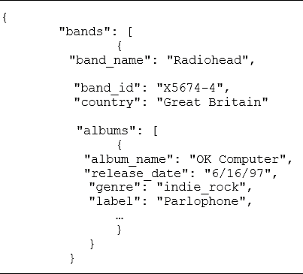
DOCUMENT DATABASES
Document Databases are a type of NoSQL Database
Data is stored in documents like JSON
Documents contain pairs of keys and values, with a key being able to fetch a value
Flexible model for semi-structured and unstructured datasets
Easy way to represent hierarchical data
Pose a risk of data redundancy and inconsistency

Slide 9
KEY VALUE DATABASES
Key Value Databases are a type of NoSQL Database
Data is stored similarly to JSON, but in a simpler format
No hierarchies
Keys correspond to values
This is just a Python dictionary
Fast read and writes, but querying is limited
user = {id:15439, "name":"yadda", "email":"test@test.com", "role":"ceo"} print(user["email"])

Slide 10
WIDE-COLUMN STORE DATABASES
Wide-column Store Databases are a type of NoSQL Database
Data is stored in tables, rows, and dynamic columns
Different rows can have different sets of columns
This makes retrieval quick and is used in big data/analytics applications
This model is very complex to implement
Name | ID | Email | dateOfBirth
Joe | 23498 | joenail@gamil.com
Toe | 29023 |  | 15/02/2024

Slide 11
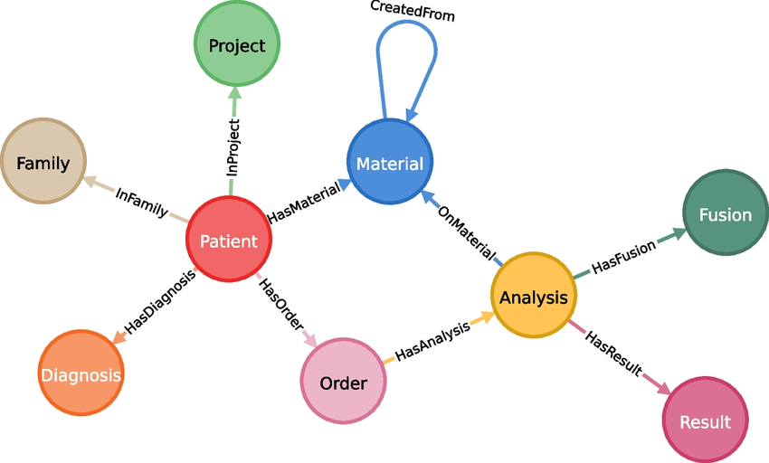
GRAPH DATABASES
Graph Databases are a type of NoSQL Database
Data is stored as nodes and edges in a graph structure
Typically store data about people, places, or things
Used for social media, recommendation engines
Much more complex to organize and maintain

Slide 12
NOSQL DATABASES
All of these types of databases are NoSQL, but are specialized for different purposes
user = {id:15439, "name":"yadda", "email":"test@test.com", "role":"ceo"} print(user["email"])
Name | ID | Email | dateOfBirth
Joe | 23498 | joenail@gamil.com
Toe | 29023 |  | 15/02/2024

Slide 13
CLOUD DATABASES
Cloud Databases are databases that run on cloud computing platforms
This provides scalability, high availability, and flexible resource management
Pricing is determined by usage, which is allocated on the fly to meet the needs of the workload
What are some potential downsides of this setup?

Slide 14
CLOUD DATABASES
There are two types of cloud databases:
Self Managed Database: database runs on a virtual machine on a system operated by a cloud vendor
Vendor gives servers, operating system, and storage devices
The purchaser must still deploy the database on the system, and do admin and maintenance tasks
Managed Database Services: Fully managed by the vendor
Vendor handles all aspects of the database,

Slide 15
CLOUD DATABASES
Some providers of cloud databases are:
Amazon DynamoDB
Amazon RDS
Azure Cosmos DB (Microsoft)
Google Cloud SQL
Azure SQL (Microsoft)
Some of these are used for startups, some target more mature enterprises

Slide 16
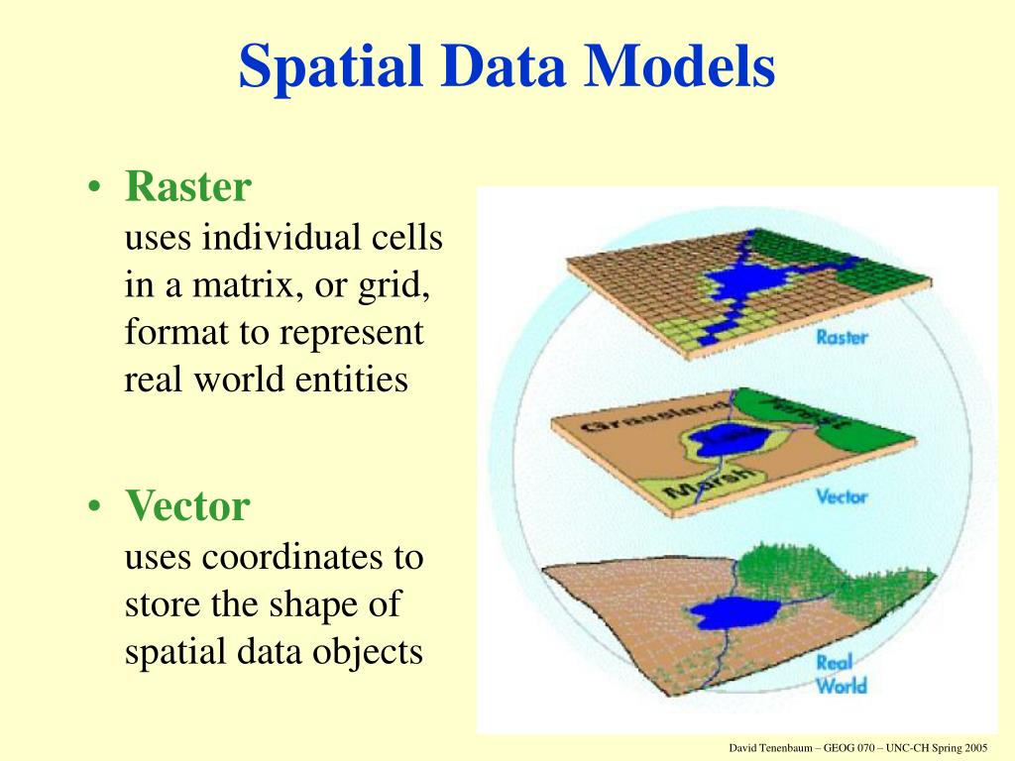
SPATIAL DATABASES
Spatial databases are optimized to store and query data objects in space
This includes points, lines, polygons, 3D shapes, and coordinates
What would be a case where you may want to use this?

Slide 17
SPATIAL DATABASES
Spatial databases are often used for:
Geographic information systems
Location based services
Mapping applications
These use complex data types and queries to store this data
This means spatial databases have a high knowledge level to use

Slide 18
IN-MEMORY DATABASES
In-memory databases store data entirely in the computer’s main memory (also known as RAM)
This is opposed to storing the data on the hard drive, which is much larger but much slower
This is extremely fast but is only used for real time analytics and gaming mostly
VERY expensive compared to normal databases

Slide 19
DATA WAREHOUSES
Data Warehouses are a specialized type of database designed for analytical purposes rather than transaction management
Recall that a transaction is adding, altering, or removing data from a database
The goal is to store an analyze large volumes of historical data from various sources to support decision making processes
Data warehouses include tools to extract, transform, and load data, as well as tools to manage and retrieve the metadata
Metadata – information about data such as time collected, data type, size in memory, etc.

Slide 20
DATA WAREHOUSES
Data Warehouse Characteristics:
Append-only: Records cannot be updated, but rather are appended to the table again
A table will contain different versions of the same record to track progress over time
Subject-oriented: organized around key subjects or themes relevant to the organization like sales, marketing, finance
Organize and present data to the needs and objectives of the organization

Slide 21
DATA WAREHOUSES
Data Warehouse Characteristics:
Integrated Data: Data from multiple sources & systems is integrated into one repository using ETL (Extract, transform, load)
Provides a single location for the data in the organization
We should ensure:
Extraction doesn’t impact source system
Extracted data can be read by current system
Data formats extracted can be converted to be readable by our system
Data is relevant to our goals

Slide 22
DATA WAREHOUSES
Data Warehouse Characteristics:
Time-variant: Data is often historical to support time based analysis
Trends and comparisons over time
Non-volatile: Data, once loaded into the data warehouse, is rarely updated or deleted, ensuring integrity and consistency
Optimized for Querying: database tries to get data as efficiently as possible
Supports the speed and efficiency of data retrieval and analysis.

Slide 23

INSTITUTION CHALLENGE
We work for a non-profit creating a Global Climate Change Tracker
The Global Climate Change tracker manages data about three things
Raw Sensor Data
Policy Relationships
Global Trend Analysis

Slide 24
INSTITUTION CHALLENGE
Raw Sensor Data:
Data: High velocity, high volume sensor readings (temperature, CO2, sea level, air quality
Data is often semi-structured
One sensor may report 10 fields, another only 5
Speed of writing data is often important
Requirement: Rapidly ingest and store massive amounts of time-stamped, heterogenous records

Slide 25
INSTITUTION CHALLENGE
Policy Relationship Mapping:
Data: entities like politicians, lobbyists, corporations, policy documents, and environmental outcomes
Core task: mapping many complex, many-to-many relationships (politician A is associated with lobbyist B, who influenced policy C, which impacts corporation D)
Requirement: Efficiently traverse and query highly interconnected nodes and relationships to uncover influence pathways

Slide 26
INSTITUTION CHALLENGE
Global Trend Analysis:
Data: aggregated, cleaned, historically maintained data from all sources (often monthly or yearly snapshots)
Data is rarely deleted and is organized around subjects like ‘Energy Consumption’ or ‘Regional Pollution Levels’
Requirement: support complex, long-running analytical queries to compare data across time, regions, and subjects to generate annual reports on global trends

Slide 27
INSTITUTION CHALLENGE
For each of these three goals, choose the best database type and explain your reasoning.
Justify the choice of your database
Explain what a potential downside of your choice is
At least three sentences each
Finally, answer the following question in a word document:
If we had only used a relational database, what kinds of questions about climate change would be difficult or impossible to answer?
Write your documentation in a word document and turn it in on ManageBac.

Slide 28

VOCABULARY TO REMEMBER
Relational Databases
NoSQL Database
Document Databases
Key-value Databases
Wide Column Store Databases
Graph Databases
Cloud Databases
Spatial Database
Data Warehouse

